Slide 1
Conceptualization of Awareness, Courage, and Love as Clinical Targets in Functional Analytic Psychotherapy
Jonathan Kanter, Ph.D.
Center for the Science of Social Connection
University of Washington

Slide 2
Need CE credit for this
session?
Please don’t forget to
scan in to have your
attendance tracked.

Slide 3
I have not received and will not receive any commercial support related to this presentation or the work presented in this presentation.

Slide 4
Need credit for this session?
Please don’t forget to
scan out.
What did you think?....
complete the 3 question quickeval
for this session at
https://contextualscience.org/quickeval
This was presentation was session # XXX

Slide 5
Follow up with me for these slides and other materials:
jonkan@uw.edu

Slide 6
Target audience: Intermediate or advanced
What does this mean?
Some kind of experiential FAP training
What are CRB1s and CRB2s?
What is FAP’s mechanism of action in behavioral language?
What are FAP’s 5 rules?

Slide 7
Informed Consent
I am going to ask you to interact in pairs with someone you don’t know.
I am going to ask you to be authentic and vulnerable in this interaction with awareness of how you are impacting your partner and maintaining safety for your partner.
Confidentiality is required and privacy must be respected.

Slide 8
Informed Consent
You will be asked to discuss things like:
What is your most treasured memory?
What do you really want people to know and understand about you?
What is your earliest memory of feeling unlovable or that something about you was unacceptable to yourself or others?
You will also be asked to share what you like about your partner and how you are feeling about the interaction with him/her.

Slide 9
Auto-pilot
Judgment
Awareness
Love
Courage
Constraint

Slide 10
What are Clinically Relevant Behaviors (CRBs)?
Anything you and your client decide you want to focus on as therapy targets
Defined behaviorally, as operants
Shows up in the therapy room as well as in the client’s life

Slide 11
The Universe of Possible FAP CRBs
O1: Outside problem | CRB1: In-session problem | CRB2: In-session Improvement | O2: Outside Improvement
Always takes care of others, not herself, wants to improve self-care and self-compassion, doesn’t know “who I am” | Overly compliant, scared to upset therapist with strong emotional displays, excessively self-critical | More compassionate self-talk, anything in-session that expresses her “best self” even if worried about punishment, expression of needs | More compassionate and proud self-talk, more expressive about own needs and empowered to engage in self-care and be herself

Slide 12
The Universe of Possible FAP CRBs
O1: Outside problem | CRB1: In-session problem | CRB2: In-session Improvement | O2: Outside Improvement
Always takes care of others, not herself, wants to improve self-care and self-compassion, doesn’t know “who I am” | Overly compliant, scared to upset therapist with strong emotional displays, excessively self-critical | More compassionate self-talk, anything in-session that expresses her “best self” even if worried about punishment, expression of needs | More compassionate and proud self-talk, more expressive about own needs and empowered to engage in self-care and be herself

Slide 13
Reinforcement
Behave
Behave
Behave
Behave
Behave
Behave
Behave
Behave
Evoke
Reinforce
Behave
Evoke
Reinforce
Behave
Evoke
Reinforce
Evoke
Reinforce
Behave
Notes:
What is the right mechanism to study?
What is the right behavioral principle?
Reinforcement

Slide 14
RULE 1
Observe: CRB2
Evoke CRB2
Reinforce CRB2
RULE 2
RULE 3
Check on your attempts at reinforcement
Promote generalization
RULE 4
RULE 5
Notes:
So one way of understanding FAP is to say that FAP teaches awareness, courage, and love, as three broad repertoires that are, well, sort of fundamental to human intimacy, and interpersonal relationships in general, but also, we believe, even more than that. Living from the perspective of awareness courage and love really allows people to be their best selves, really allows people to reach their full potential as human beings.
And a behavioral theory, and a behavioral way of looking at all of this, really holds all of this together. You can say that being a FAP therapist involves cultivating these broad repertoires of awareness, courage, and love, and then – with a behavioral understanding, tailoring these repertoires to the specific needs and requirements of the therapy relationship to maximize the power and potential of the therapy experience.

Slide 15
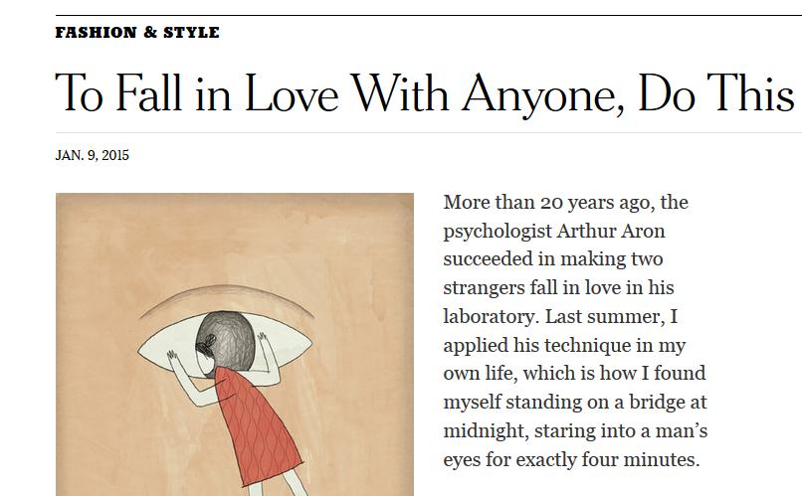

Slide 16
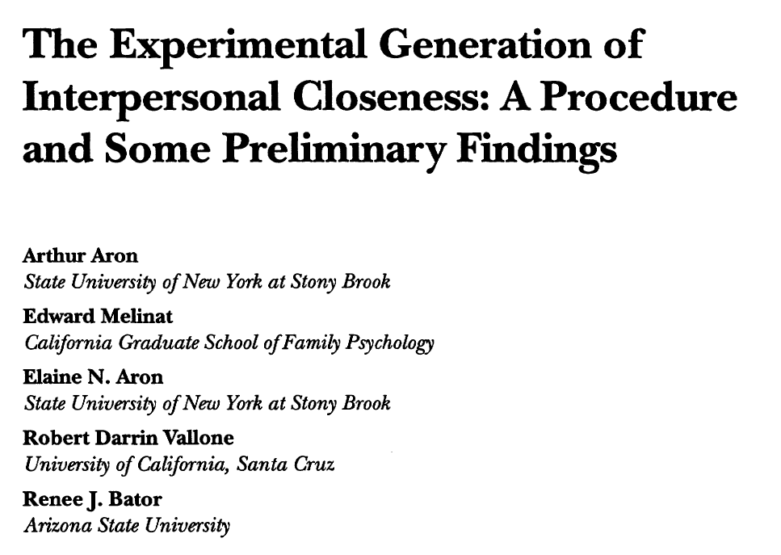

Slide 17
Question 1:
Who would you most like to have dinner with, living or dead, and why?
Question 2:
What is your most treasured memory?
Question 3:
What do you like about me so far?
A
Respond to question
B
Respond to response
Respond to response
Respond to question
D
C

Slide 18
Debrief:
How was doing this with each other? How does it feel to have done this together?

Slide 19
The “Fast Friends” Procedure
Conclusion:
Many studies show that the fast friends procedure can quickly create intimacy, friendship and love.

Slide 20
Awareness
Courage
Love

Slide 21
…of your feelings, thoughts, urges, needs, values, history
…of the other’s feelings, thoughts, urges, needs, values, history
Awareness
Mindfulness, acceptance, values, and perspective taking
Courage
Love
Balance Reciprocity
1
Experiential avoidance; non-verbal
Vulnerably
accepting love
Being vulnerable
Providing safety (acceptance)
2
Understanding (empathy)
“Speaking your truth”;
“I am…”, “I feel…” (tacting)
Self-disclosing
closeness
Self-disclosing
3
Questions
For closeness
For changes
For self-care
“I need...” (manding)
Asking
Giving
?
4
Connecting
Loving
Self-care

Slide 22
Orient your awareness to this present-moment between you and your partner

Slide 23
Question:
What do you really want people to know and understand about you?
A
Respond to question with courage
B
Respond to response with love
Respond to response with love
Respond to question with courage
D
C

Slide 24
Debrief:
Share your experience of connection and closeness with each other

Slide 25
…of your feelings, thoughts, urges, needs, values, history
…of the other’s feelings, thoughts, urges, needs, values, history
Awareness
Courage
Love
Balance Reciprocity
“Classic” FAP Client Profile
Vulnerably
accepting love
1
Providing safety (acceptance)
Being vulnerable
Existing Strengths
Self-disclosing
closeness
2
Self-disclosing
Understanding (empathy)
Targets
The targets are the client’s CRB2s: These are what you try to observe (Rule 1), evoke (Rule 2), and reinforce (Rule 3) in session.
3
Questions
For closeness
For changes
For self-care
Asking
Giving
4
Connecting
Loving
Self-care

Slide 26
…of your feelings, thoughts, urges, needs, values, history
…of the other’s feelings, thoughts, urges, needs, values, history
“Stressed-out Dad” FAP Client Profile
Awareness
Courage
Love
Balance Reciprocity
Vulnerably
accepting love
1
Providing safety (acceptance)
Being vulnerable
Existing Strengths
Self-disclosing
closeness
2
Self-disclosing
Understanding (empathy)
Targets
The targets are the client’s CRB2s: These are what you try to observe (Rule 1), evoke (Rule 2), and reinforce (Rule 3) in session.
3
Questions
For closeness
For changes
For self-care
Asking
Giving
4
Connecting
Loving
Self-care

Slide 27
…of your feelings, thoughts, urges, needs, values, history
…of the other’s feelings, thoughts, urges, needs, values, history
Awareness
Courage
Love
Balance Reciprocity
My Profile
Vulnerably
accepting love
1
Providing safety (acceptance)
Being vulnerable
Existing Strengths
Self-disclosing
closeness
2
Self-disclosing
Understanding (empathy)
Targets
The targets are the client’s CRB2s: These are what you try to observe (Rule 1), evoke (Rule 2), and reinforce (Rule 3) in session.
3
Questions
For closeness
For changes
For self-care
Asking
Giving
4
Connecting
Loving
Self-care

Slide 28
ACL self-assessment
5 min: Complete the “your self assessment” column
5 min: Share your self-assessment with your partner. Complete the “your partner’s observations” column.
5 min: Switch.

Slide 29
RULE 1
Observe: CRB2
Evoke CRB2
Reinforce CRB2
RULE 2
RULE 3
Check on your attempts at reinforcement
Promote generalization
RULE 4
RULE 5
Notes:
So one way of understanding FAP is to say that FAP teaches awareness, courage, and love, as three broad repertoires that are, well, sort of fundamental to human intimacy, and interpersonal relationships in general, but also, we believe, even more than that. Living from the perspective of awareness courage and love really allows people to be their best selves, really allows people to reach their full potential as human beings.
And a behavioral theory, and a behavioral way of looking at all of this, really holds all of this together. You can say that being a FAP therapist involves cultivating these broad repertoires of awareness, courage, and love, and then – with a behavioral understanding, tailoring these repertoires to the specific needs and requirements of the therapy relationship to maximize the power and potential of the therapy experience.

Slide 30
Rule 1 is about awareness…exquisite sensitivity to yourself, the other, and your interaction
…of your feelings, thoughts, urges, needs, values, history
…of the other’s feelings, thoughts, urges, needs, values, history
Awareness
Courage
Love
Balance Reciprocity
Vulnerably
accepting love
1
Providing safety (acceptance)
Being vulnerable
Self-disclosing
closeness
2
Self-disclosing
Understanding (empathy)
3
Questions
For closeness
For changes
For self-care
Asking
Giving
?
4
Connecting
Loving
Self-care

Slide 31
Rule 1: Observing CRBs
Look for CRBs in the therapy process
—pay exquisite attention to the direct, live, present-moment experience and behavior of the client—
as per your case conceptualization…
…no matter what the content of the discussion is about.

Slide 32
Rule 1: Observing CRBs
Switching from content to process
A conversation about your childhood, religious beliefs, sexuality, something you are proud of, a memory of something….
Is the client engaged in CRB2s? Expressing vulnerability? Asking for what they need? Expressing safety and acceptance?
What is the content?
What is the process?

Slide 33
“I’ve been trying to talk about your family for several minutes already and you are changing the subject and you look irritated with me. What is happening right now?”
(self-awareness)

Slide 34
“I see you look like you want to cry. Are you closing up or are you open and vulnerable? I can’t tell.”
(being vulnerable)

Slide 35
“Wow, there seems like so much sadness under the surface for you today. Are you wanting to talk to me about it, but not sure how?”
(self-disclosing)

Slide 36
“You are complaining about how difficult it was for you to get to session on time. I am wondering if, partially, you might still be upset about the discussion we had regarding fees last week?”
(being vulnerable and asking)

Slide 37
Rule 2 is about courage…
…of your feelings, thoughts, urges, needs, values, history
…of the other’s feelings, thoughts, urges, needs, values, history
Awareness
Courage
Love
Balance Reciprocity
Vulnerably
accepting love
1
Providing safety (acceptance)
Being vulnerable
Self-disclosing
closeness
2
Self-disclosing
Understanding (empathy)
3
Questions
For closeness
For changes
For self-care
Asking
Giving
?
4
Connecting
Loving
Self-care

Slide 38
Rule 2: Evoking CRB
Invite the client to engage in CRB2
…as per the case conceptualization

Slide 39
Evokes are invitations to engage in CRB2
“As you are talking right now, can you connect more to yourself and try to connect to the emotions and any feelings in your body? What is happening in your body right now as you talk about this?”

Slide 40
Rule 2: Evoking CRB
Invite the client to engage in CRB2
…as per the case conceptualization
The strongest evokes are direct and focused on live, present-moment experience.

Slide 41
“I know this is hard for you…how would it feel if you were to stay with these emotions for a bit? Would that be scary?”
“I know this is hard for you…let’s stay with these emotions for a bit right now. I am with you.”

Slide 42
“How are you feeling?
“How are you feeling, right now? Really. Are you reacting to what I just said? Are you upset with me right now?”

Slide 43
Rule 2: Evoking CRB
Invite the client to engage in CRB2
…as per the case conceptualization
The strongest evokes are direct and focused on live, present-moment experience.
Authentically express to the client that the loving reinforcement is available.

Slide 44
I want you to know that you are totally safe with me. It is ok to risk.

Slide 45
I feel nothing but acceptance and love for you in this moment. You could say almost anything and this will not change.

Slide 46
I have this great desire to express empathy and understanding for you. Give me a chance.

Slide 47
I really want a chance to give you what you need if you ask for it.

Slide 48
Rule 2: Evoking CRB
Invite the client to engage in CRB2
…as per the case conceptualization
The strongest evokes are direct and focused on live, present-moment experience.
Authentically express to the client that the loving reinforcement is available.
In response to CRB2, courageously re-evoke to invite the client to go deeper into CRB2.

Slide 49
“You’ve told me a lot just now. Is there anything you’re still holding back? I would love for you to get every last bit of it out, so I can hear it.”

Slide 50
Rule 2: Evoking CRB
Invite the client to engage in CRB2
…as per the case conceptualization
The strongest evokes are direct and focused on live, present-moment experience.
Authentically express to the client that the loving reinforcement is available.
In response to CRB2, courageously re-evoke to invite the client to go deeper into CRB2.
In response to CRB1, couragously re-evoke to invite the client to engage in CRB2.

Slide 51
“I want you to know that you are totally safe with me. It is ok to risk.

Slide 52
Rule 3 is about love
…of your feelings, thoughts, urges, needs, values, history
…of the other’s feelings, thoughts, urges, needs, values, history
Awareness
Courage
Love
Balance Reciprocity
Vulnerably
accepting love
1
Providing safety (acceptance)
Being vulnerable
Self-disclosing
closeness
2
Self-disclosing
Understanding (empathy)
3
Questions
For closeness
For changes
For self-care
Asking
Giving
?
4
Connecting
Loving
Self-care

Slide 53
Rule 3: Reinforcing CRB2
Ensure you have the client’s attention.

Slide 54
“I really want you to pay attention to me right now. Can you really, for just a moment, focus on me and what I am about to say? I want you to hear every word, and I want you to notice the warmth and safety that is expressed on my face.”

Slide 55
Rule 3: Reinforcing CRB2
Ensure you have the client’s attention.
Notice and point out even the smallest improvements.

Slide 56
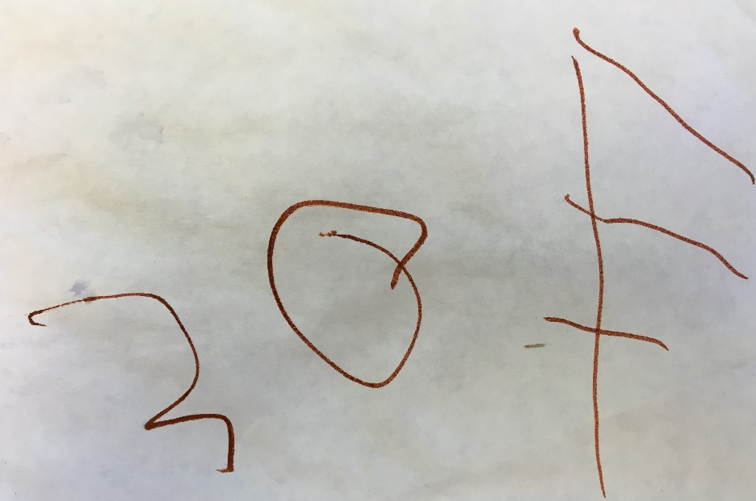
Notice and point out even the smallest improvements…
…even those 2s that might not be reinforced by others in the outside world.
Improvement over time
Notes:
Let’s start with the basics – how can you maximize opportunities to reinforce? Scour each turn for successive approximations of client vulnerability, self-disclosure, asking and connecting. Approximations are emerging 2’s and are the MOST important behaviors to reinforce. Behaviors that have been well-shaped and are being maintained in the client’s repertoire, though they might be nearly perfect, are less important to reinforce than those new behaviors that may not be perfectly polished but represent a new stretch for the client in their desired direction.

Slide 57
“Can you just acknowledge, to yourself, in this moment, that you are more aware of your feelings and who you are as we are speaking to each other?”
(self awareness)

Slide 58
“You look really aware of me right now. I can just see a difference in your eye contact”
(other awareness)

Slide 59
“That was really brave of you”
(being vulnerable)

Slide 60
“I can see, right now, how you are working on letting yourself feel these really difficult feelings”
(being vulnerable)

Slide 61
“I am seeing you trying to accept my feelings of caring for you”
(vulnerably accepting love)

Slide 62
Rule 3: Reinforcing CRB2
Ensure you have the client’s attention.
Notice and point out even the smallest improvements.
Provide the response in the ACL model if it is authentic.

Slide 63
…of your feelings, thoughts, urges, needs, values, history
…of the other’s feelings, thoughts, urges, needs, values, history
Awareness
If your client does this…
Do this
Courage
Love
Balance Reciprocity
Vulnerably
accepting love
1
Providing safety (acceptance)
Being vulnerable
Self-disclosing
closeness
2
Self-disclosing
Understanding (empathy)
3
Questions
For closeness
For changes
For self-care
Asking
Giving
?
4
Connecting
Loving

Slide 64
…of your feelings, thoughts, urges, needs, values, history
…of the other’s feelings, thoughts, urges, needs, values, history
Awareness
If your client does this…
Do this
Courage
Love
Balance Reciprocity
Vulnerably
accepting love
1
Providing safety (acceptance)
Being vulnerable
Self-disclosing
closeness
2
Self-disclosing
Understanding (empathy)
3
Questions
For closeness
For changes
For self-care
Asking
Giving
?
4
Connecting
Loving

Slide 65
…of your feelings, thoughts, urges, needs, values, history
…of the other’s feelings, thoughts, urges, needs, values, history
Awareness
If your client does this…
Do this
Courage
Love
Balance Reciprocity
Vulnerably
accepting love
1
Providing safety (acceptance)
Being vulnerable
Self-disclosing
closeness
2
Self-disclosing
Understanding (empathy)
3
Questions
For closeness
For changes
For self-care
Asking
Giving
?
4
Connecting
Loving

Slide 66
…of your feelings, thoughts, urges, needs, values, history
…of the other’s feelings, thoughts, urges, needs, values, history
Awareness
Courage
Love
Balance Reciprocity
Vulnerably
accepting love
1
Providing safety (acceptance)
Being vulnerable
Self-disclosing
closeness
2
Self-disclosing
Understanding (empathy)
3
Questions
For closeness
For changes
For self-care
Asking
Giving
?
If your client does this…
4
Do this
Connecting
Loving

Slide 67
…of your feelings, thoughts, urges, needs, values, history
…of the other’s feelings, thoughts, urges, needs, values, history
Awareness
If your client does this…
Do this
Courage
Love
Balance Reciprocity
Vulnerably
accepting love
1
Providing safety (acceptance)
Being vulnerable
Self-disclosing
closeness
2
Self-disclosing
Understanding (empathy)
3
Questions
For closeness
For changes
For self-care
Asking
Giving
?
If your client does this…
4
Do this
Connecting
Loving

Slide 68
Rule 3: Reinforcing CRB2
Ensure you have the client’s attention.
Notice and point out even the smallest improvements.
Provide the response in the ACL model if it is authentic.
Involve yourself personally, authentically, and vulnerably in the response.

Slide 69
Meditate on your partner’s case conceptualization. Consider how your strengths and targets interact with your partner’s.

Slide 70
Question:
What is your earliest memory of feeling unlovable or that something about you was unacceptable to yourself or others?
A
Respond to question with courage
B
Respond to response with love
Respond to response with love
Respond to question with courage
D
C

Slide 71
Debrief:
Share your experience of connection and closeness with each other

Slide 72
Loneliness/lack of social connection equivalent to smoking 15 cigarettes a day
=
Holt-Lunstad J, Smith TB, Layton JB (2010) Social Relationships and Mortality Risk: A Meta-analytic Review. PLoS Med 7(7): e1000316. doi:10.1371/journal.pmed.1000316
Notes:
The way to read this chart: “Living with air pollution increases your odds of an early death by 5%. Obesity increases your odds of an early death by 20%....
http://www.plosmedicine.org/article/info%3Adoi%2F10.1371%2Fjournal.pmed.1000316#s4

Slide 73
Awareness, Courage, and Love Model of Social Connection
Center for the Science of Social Connection
Model of ACL
Clinical Experience
Evolutionary biology
Neuroscience
Basic research
Contextual behavioral science
Improve intimate relations and social connectedness

Slide 74
Different kinds of social connections
Intimate relationships
At least one intimate, confidential trusting relationship
(not including a
therapist)
Perceived social support
Supportive people, e.g., friends who help when we are sick or in financial trouble, or when we are just feeling sad and lonely
Participation in social networks
Being a part of a community, or different communities

Slide 75
…of your feelings, thoughts, urges, needs, values, history
…of the other’s feelings, thoughts, urges, needs, values, history
Intimate relationships
At least one intimate, confidential trusting relationship
(not including a
therapist)
Awareness
Courage
Love
Balance Reciprocity
Vulnerably
accepting love
1
Providing safety (acceptance)
Being vulnerable
Self-disclosing
closeness
2
Self-disclosing
Understanding (empathy)
3
Questions
For closeness
For changes
For self-care
Asking
Giving
4
Connecting
Loving
Self-care

Slide 76
…of your feelings, thoughts, urges, needs, values, history
…of the other’s feelings, thoughts, urges, needs, values, history
Perceived social support
Supportive people, such as friends who help when we are sick or in financial trouble, or when we are just feeling sad and lonely
Awareness
Courage
Love
Balance Reciprocity
Vulnerably
accepting love
1
Providing safety (acceptance)
Being vulnerable
Self-disclosing
closeness
2
Self-disclosing
Understanding (empathy)
3
Questions
For closeness
For changes
For self-care
Asking
Giving
4
Connecting
Loving
Self-care

Slide 77
…of your feelings, thoughts, urges, needs, values, history
…of the other’s feelings, thoughts, urges, needs, values, history
Participation in social networks
Being a part of a community, or different communities
Awareness
Courage
Love
Balance Reciprocity
Vulnerably
accepting love
1
Providing safety (acceptance)
Being vulnerable
Self-disclosing
closeness
2
Self-disclosing
Understanding (empathy)
3
Questions
For closeness
For changes
For self-care
Asking
Giving
4
Connecting
Loving
Self-care

